Slide 1
Computer Vision

Slide 2
Computer Vision (CV) Introduction

Slide 3


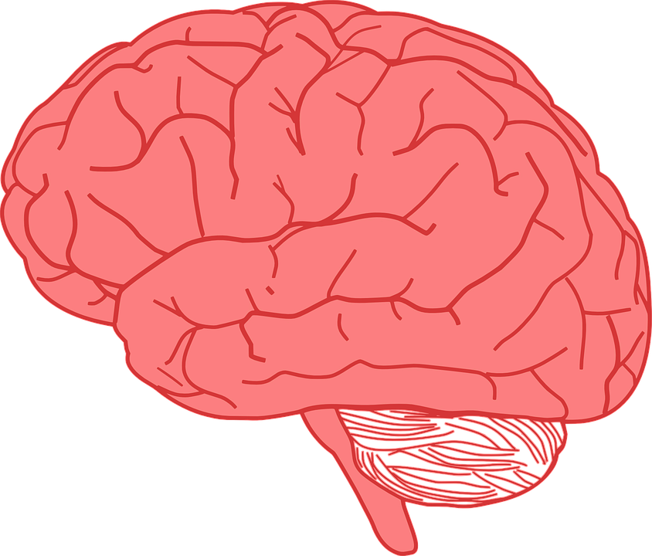
Visual perception
How can people see and recognize things?
We see with our eyes
We process what we see with our brain

Slide 4

Computer Vision
How is it possible for a computer to see and recognize objects?
Notes:
what do you do think ?
How does it work ?

Slide 5
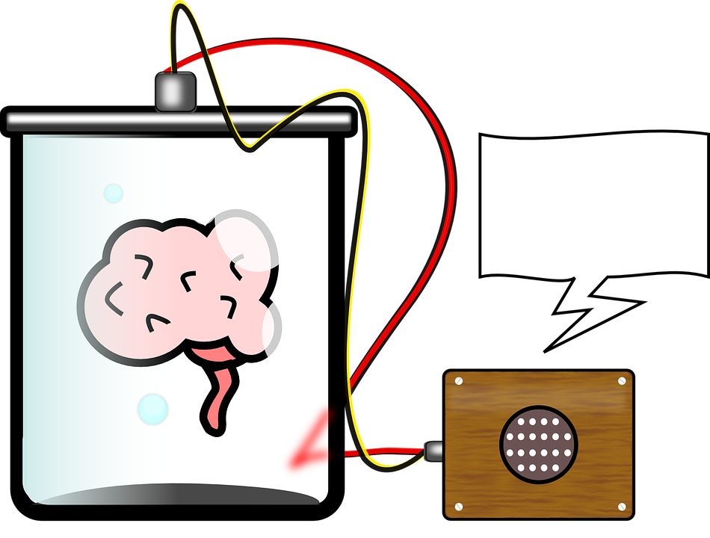



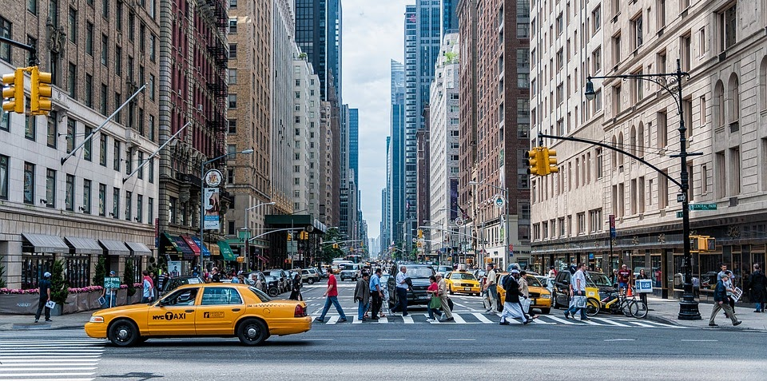

Computer Vision
General functionality
training
take a picture
process information
traffic lights
cars
pedestrian
cars
result

Slide 6


Some CV tasks
classification + localization
classification
object detection
Cat
Cat on position X,Y
Cat , rat , dog , table
Discover other applications of CV - interactive:
https://aidemos.microsoft.com/computer-vision/recognize

Slide 7
Digital Images - Basics

Slide 8
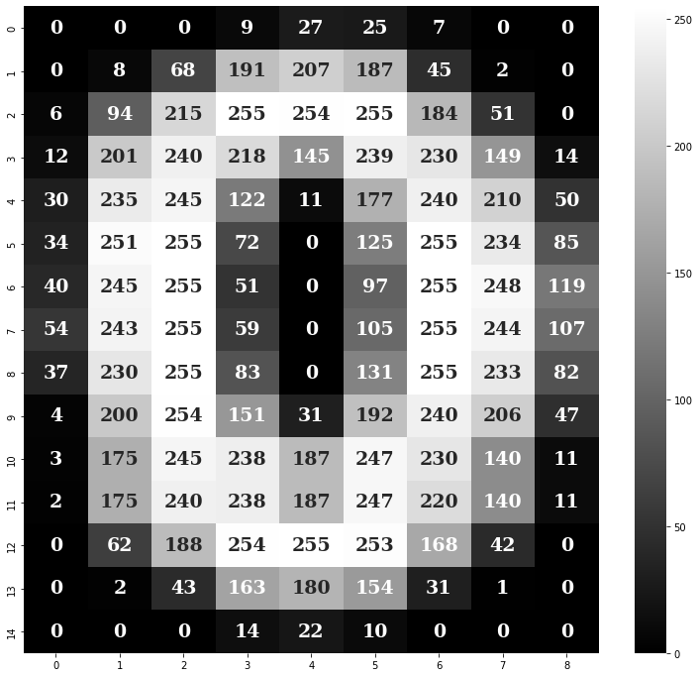

How are images processed?
Images are made up of pixels
Pixels have color values
Grayscale images can be saved easily

Slide 9
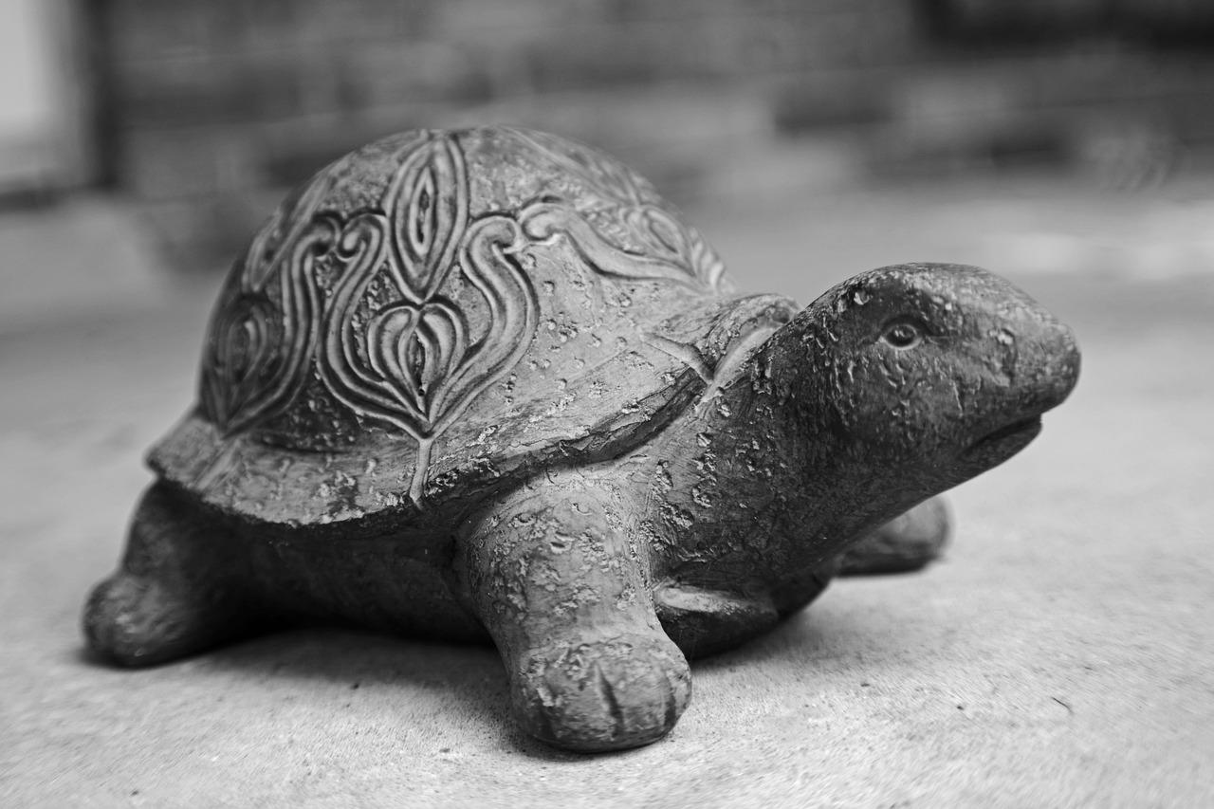


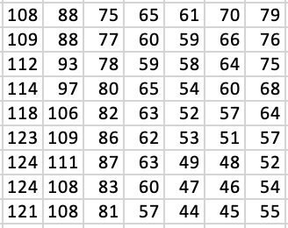
A first comparison
The computer "sees"
We see

Slide 10





Flood fill algorithm
How could this algorithm work?
Write down the individual steps

Slide 11
Flood fill algorithm
How could this algorithm work?
Take two colors (background and font color)
Place the brush on a starting point
Keep painting until the point under the brush has a different color than the background
When everything is painted, check how much of the brush color was used

Slide 12
Flood fill algorithm
What problems could arise?

Slide 13
Classic CV Algorithms

Slide 14
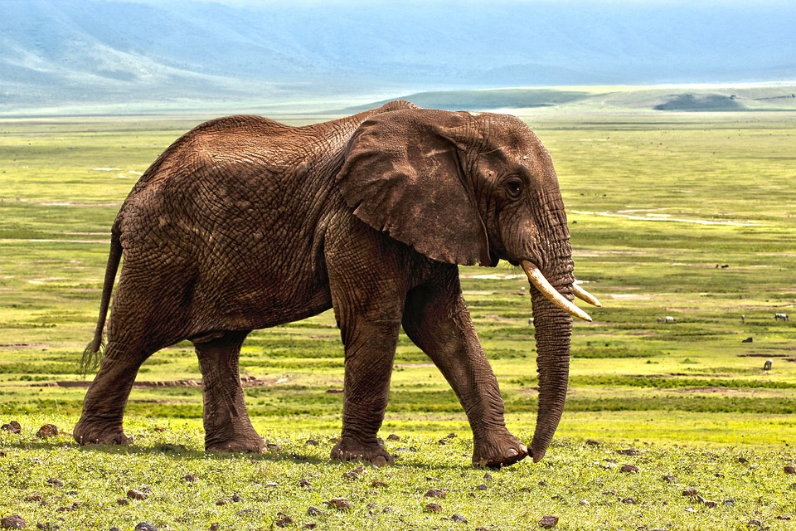
Qhat do you see

Slide 15

… and now?
Image created with https://openai.com/dall-e-2/
Notes:
The information in this picture is abstracted to the essential. We only have the edge information and can recognize it as an elephant.
Image created using Dall-E 2

Slide 16

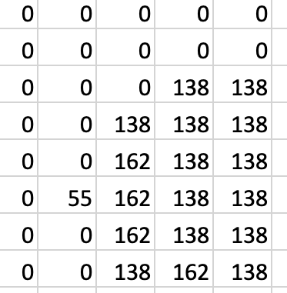

Edge detection algorithm

Slide 17



Horizontal Edges

Slide 18
Calculate horizontal edges
 | A | B | C | D
a | 255 | 255 | 255 | 255
b | 234 | 239 | 234 | 241
c | 40 | 0 | 8th | 98
i.e | 0 | 0 | 4 | 0
calculation rules
Aa - Ab
Ba - Bb
Ca – Cb
Da – Db
...

Slide 19
Calculate horizontal edges
 | A | B | C | D
a | 255 | 255 | 255 | 255
b | 234 | 239 | 234 | 241
c | 40 | 0 | 8th | 98
i.e | 0 | 0 | 4 | 0
 | A | B | C | D
a | 21 | 16 | 21 | 14
b | 194 | ? | ? | ?
c | ? | ? | ? | ?
i.e | ? | ? | ? | ?
Aa - Ab
Ba – Bb
Ca – Cb
Da – Db
Ab – Ac = 234 – 40 ➔ 194
Notes:
solution :
| A | B | C | D
a | 21 | 16 | 21 | 14
b | 194 | 239 | 226 | 143
c | 40 | 0 | 4 | 98

Slide 20


Vertical edges

Slide 21
Calculate vertical edges
 | A | B | C | D
a | 255 | 255 | 49 | 1
b | 255 | 239 | 1 | 0
c | 255 | 249 | 4 | 0
i.e | 250 | 250 | 57 | 0
calculation rules
Aa-Ba
Ab - Ba
Ac - Bb
Ad – Bd
...
?
Ba - Ba = 255 - 49 ➔ 206

Slide 22
vertical edge to calculate
 | A | B | C | D
a | 255 | 255 | 49 | 1
b | 255 | 239 | 1 | 0
c | 255 | 249 | 4 | 0
i.e | 250 | 250 | 57 | 0
 | A | B | C | D
a | 0 | 206 | ? | ?
b | 16 | ? | ? | ?
c | 6 | ? | ? | ?
i.e | 0 | ? | ? | ?
Aa-Ba
Ab - Ba
Ac - Bb
Ad – Bd
Notes:
solution :
| A | B | c
a | 0 | 206 | 48
b | 16 | 238 | 1
c | 6 | 245 | 4
d | 0 | 193 | 56
​
​

Slide 23

Combination of edges
+
=

Slide 24


Combining the Edges

Slide 25
Comparison with original image
Can the computer 'recognize' what's in the picture?
No – further steps are necessary for this
Further processing of the detected edges
Recognizing shapes (rectangle, circle, ...)
Supervised Learning

Slide 26
Face Recognition

Slide 27
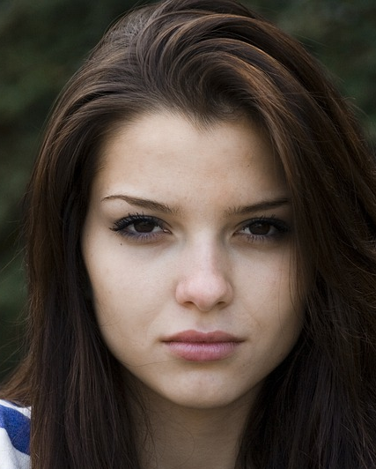
Face recognition
How would you recognize a face in a picture?

Slide 28
face recognition
What features does a human face have?
Eyebrows are darker than the forehead
Bridge of the nose is lighter than...
Other features?

Slide 29
Face recognition
How does a computer recognize a face in an image?

Slide 30
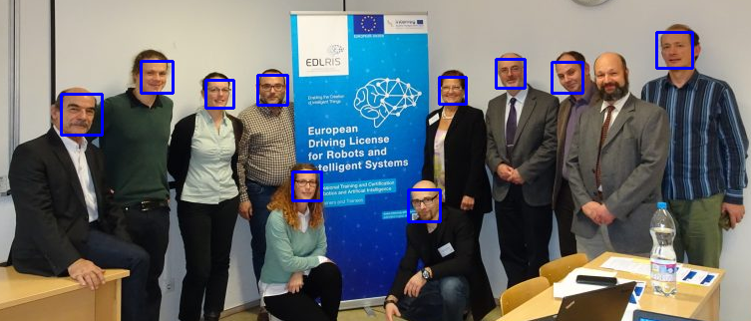
Viola Jones Algorithm
developed in 2001 by Paul Viola and Michael Jones
efficient pattern recognition in real time
pictures and videos
detects faces , but does not distinguish them
Notes:
Paul Viola and Michael Jones

Slide 31
Sliding window
Images can contain more than one face
Sections (red rectangle) are examined
The size of the subsections is adjusted

Slide 32
Essentials Viola Jones
Haar-like features are small boxes that use mathematical calculations to help the algorithm recognize the different parts of a face
edge features
line features
four rectangle features
Features do not have a fixed size and can be adjusted as needed

Slide 33
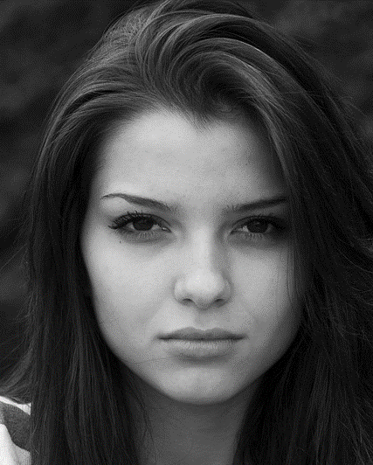
Haar-like features
Image converted to grayscale
Search for specific characteristics (features)

Slide 34

So how does this algorithm work?
... let's look at a few practical examples
Link to video : https://www.youtube.com/watch?v=hPCTwxF0qf4 _

Slide 35
Worksheet Viola Jones
First, place the red rectangle with the top left corner on section A1 of the printed image
Investigate which features would fit in the current segment (red rectangle). Proceed in the following order:
check first
then
finally
if one of the features does not appear in the segment, you can go straight to step 3
a face was only recognized if all three features occur in a segment
Place the red rectangle one after the other on segment B1, C1, A2, B2, C2, A3, B3, C3, A4, B4, C4 and repeat step 2 for each segment

Slide 36


Worksheet Viola Jones
no face
no face
no face
face found!

Slide 37

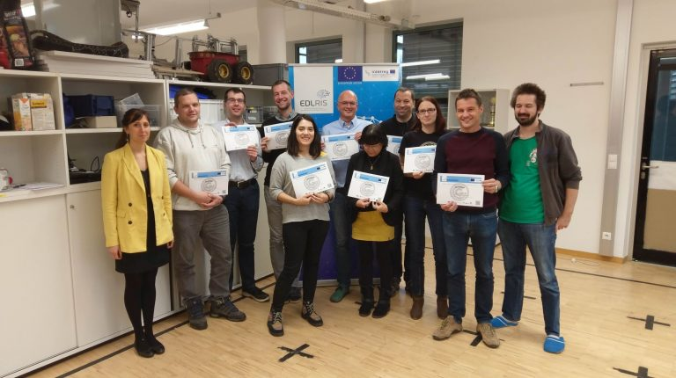
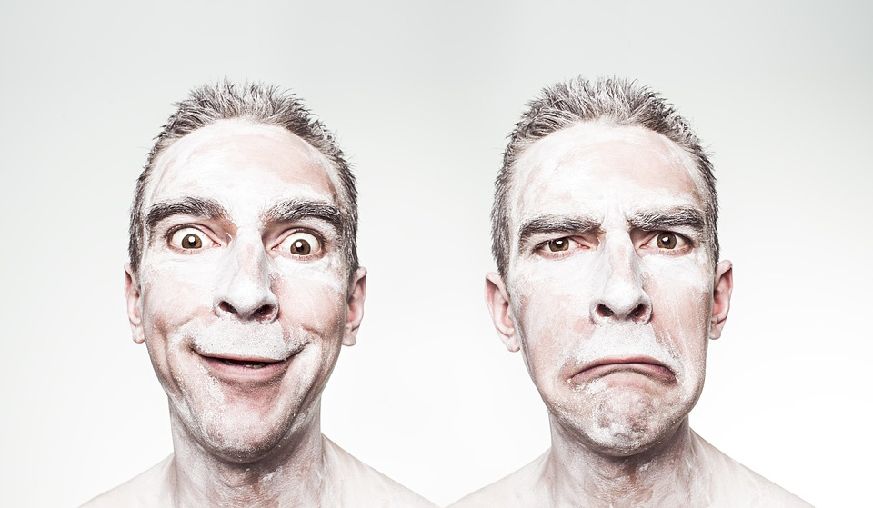
Exercise advanced
Try the Viola Jones algorithm in Python (ViolaJones.py)
Change the following parameters to recognize as many faces as possible in the images:
scaleFactor
minNeighbors
minSize
Notes:
good solution:
scaleFactor = 1.1
minNeighbors = 4
minSize =( 20 , 20 )

Slide 38
Machine Learning in CV

Slide 39
Short Summary
train model
Enter image with object(s) to be recognized
Process image and compare with trained model
output of the results
traffic lights
cars
pedestrian
Supervised Learning

Slide 40
Now it's time to develop your own computer vision algorithm !
https://machinelearningforkids.co.uk/?lang=en
"Face Unlock for Smartphones"

Slide 41
Discussion
Opportunities and Limitations

Slide 42

Time for the discussions...
Can you think of an exciting application for computer vision from your everyday life?
How could you confuse the computer?
... and what dangers could result from this?

Slide 43
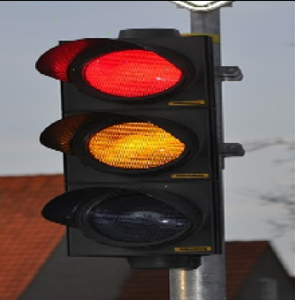
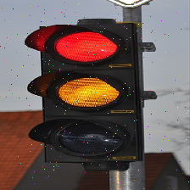
Fooling the AI
original image
after pixel changes
classified as:
traffic light (99%)
classified as:
Can Opener (85%)
Notes:
Further Info : https://towardsdatascience.com/fooling-neural-networks-with-adversarial-examples-8afd36258a03

